Slide 1
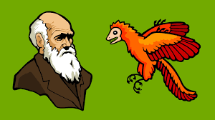
Evidence of Evolution

Slide 2
10.1 Early Ideas About Evolution
After this section you will be able to……
Explain what species is an the mechanisms of evolution
Describe the theory of geological change

Slide 3
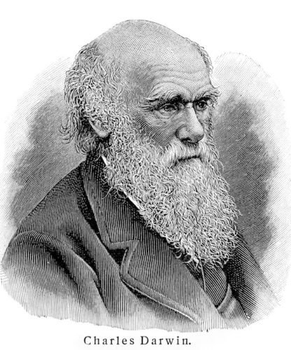
Early Ideas About Evolution
There were theories of biological and geologic change before Darwin.
Evolution is the process of biological change by which descendants come to differ from their ancestors.
Most of today’s understanding of evolution is based on Darwin’s work in the 1800’s, but he did not come up with the idea.

Slide 4
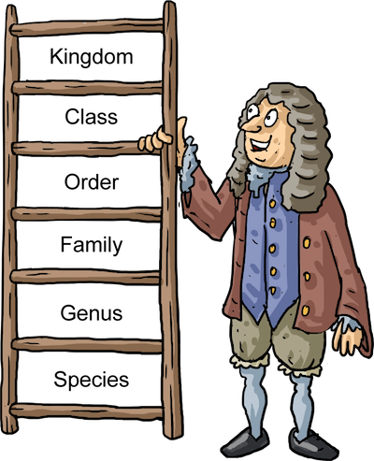
Species
A species is a group of organisms that can reproduce and have fertile offspring. The system was created in the 1700’s by a botanist named Carolus Linnaeus.
Linnaeus grouped organisms by physical similarities. This system shows evolutionary relationships and is still in use today.
During his time, it was believed that organisms on Earth did not change, but he proposed the opposite.

Slide 5
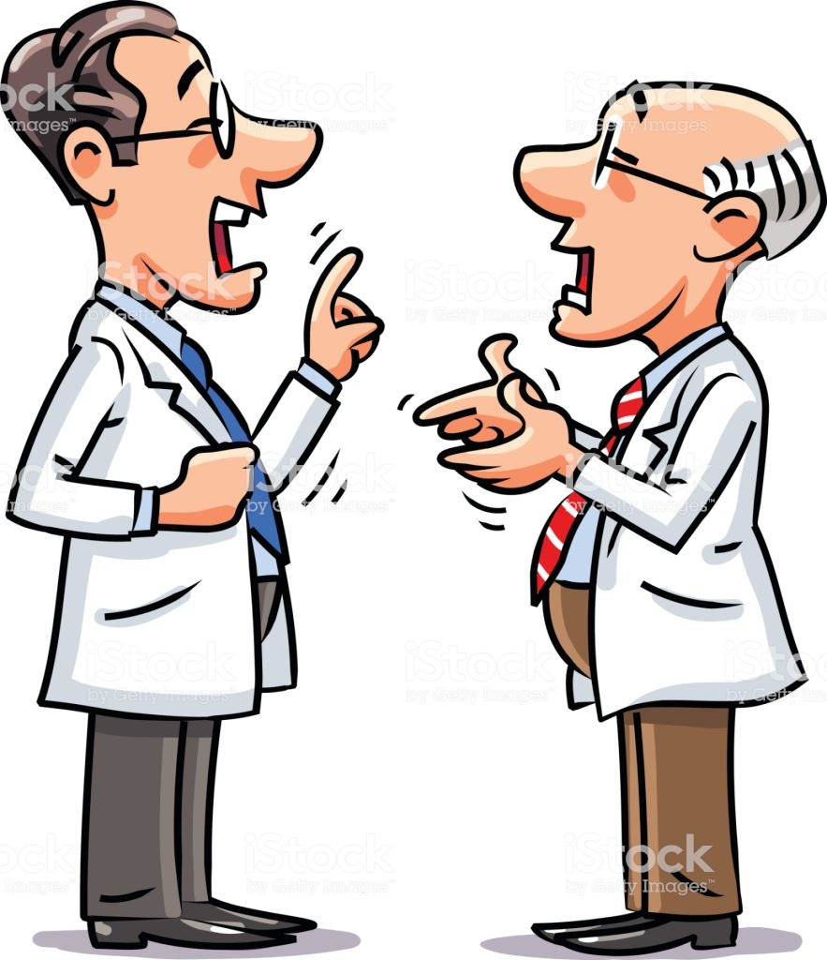
Mechanisms of Evolution
There were many ideas from multiple scientists in the 1700’s that described how species could change.
They can change
They can’t change
Environment affects evolution
Environment doesn’t affect evolution
The Earth is 6000 years old
The Earth is older than 6000 years

Slide 6
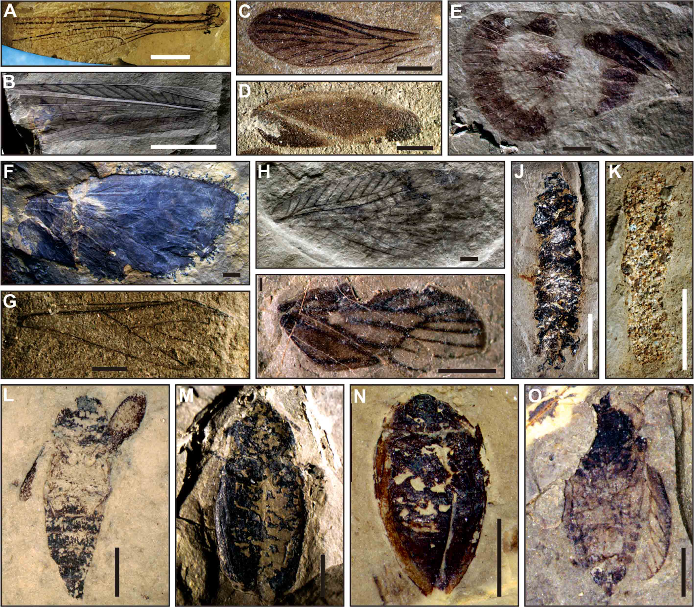
Theories of Geological Change
Some scientists concluded that species do go extinct once they started studying fossils. Fossils are traces of organisms that existed in the past.
The location of fossils in different rock layers provide clues about Earth’s past, but different ideas came from different geologists.

Slide 7
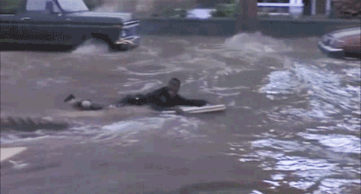
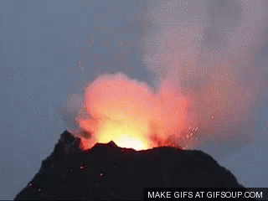
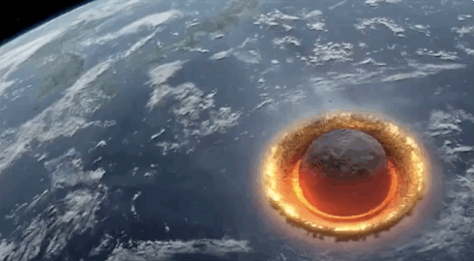
Theories of Geological Change
Catastrophism is the idea that past natural disasters, such as floods and volcanic eruptions, shaped landforms and caused species to become extinct in the process.

Slide 8
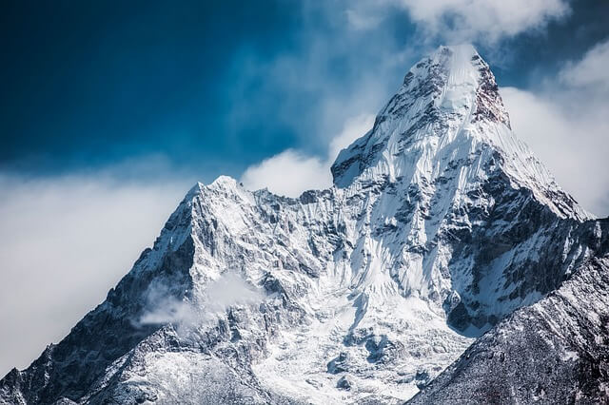
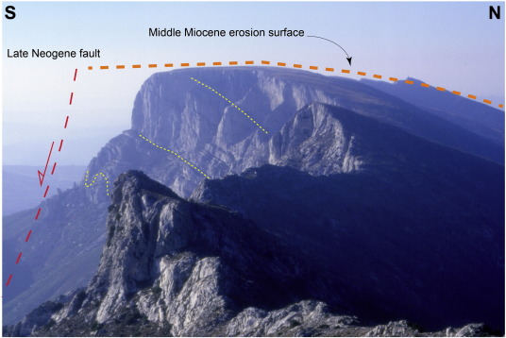
Theories of Geological Change
Gradualism is the idea that landforms were shaped by very slow changes over a long period of time, and not by natural disasters.

Slide 9
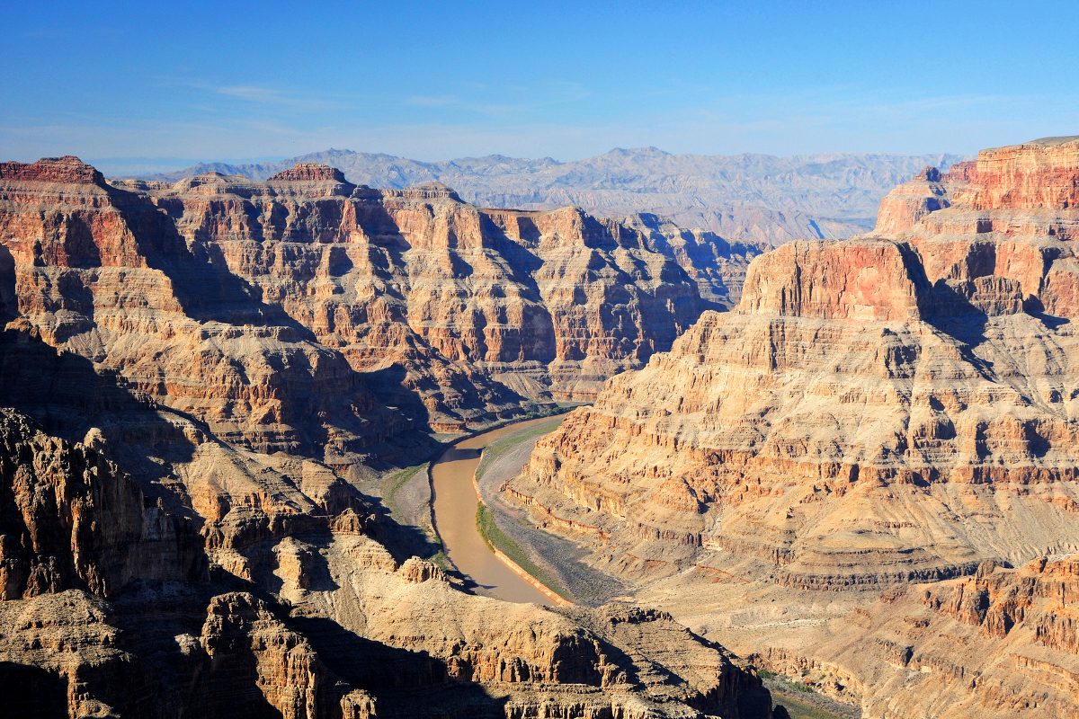
Theories of Geological Change
Uniformitarianism is the idea that the same processes that shaped landforms in the past also shape landforms today. In other words, the geologic processes that shape Earth are uniform, or the same, through time. Uniformitarianism became the favored theory of geologic change and played an important role in the development of Darwin’s theory.

Slide 10
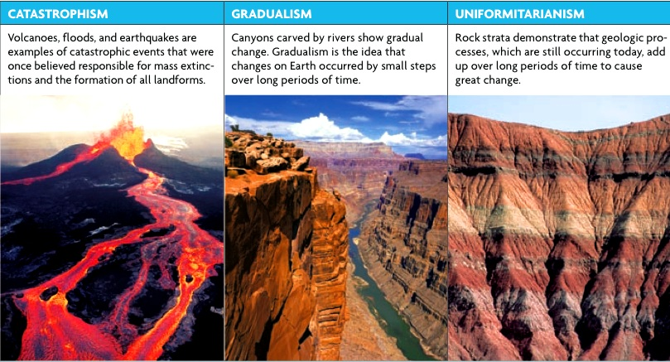

Slide 11
10.2 Darwin’s Observations
After this section you will be able to……
Explain Darwin’s observations among island species
Explain Darwin’s observations among fossil and geological evidence

Slide 12
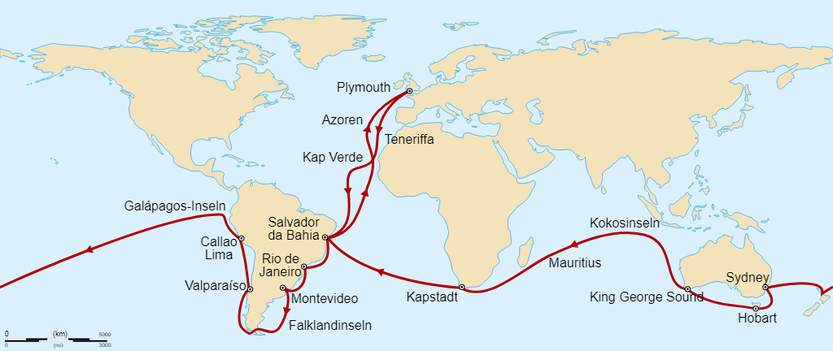
Species Observations
Charles Darwin sailed the coast of South America and the Pacific islands and spent over 20 years researching biological evolution. Darwin was amazed at the variation (differences in physical traits among individuals in a group of organisms) that he observed in his travels.

Slide 13
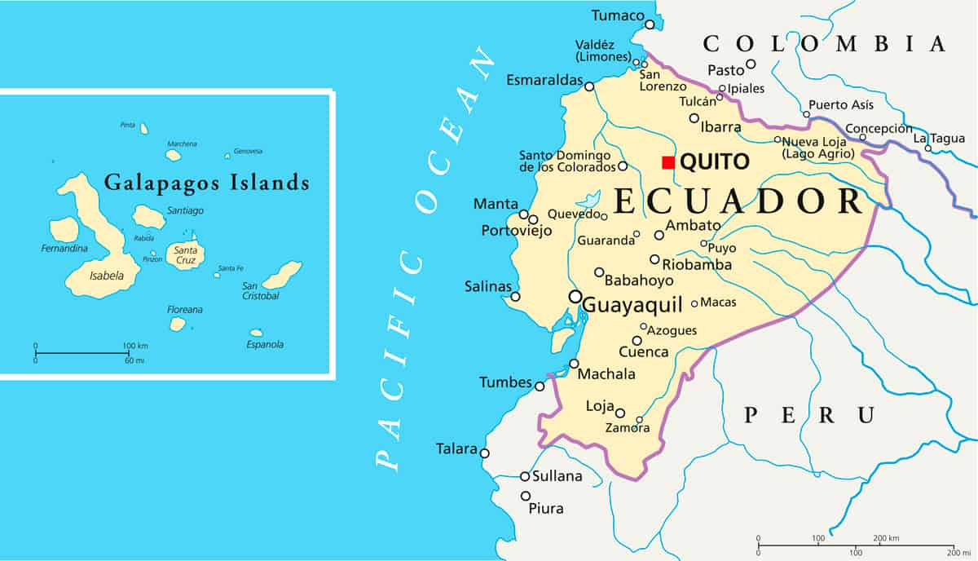
Species Observations
Darwin noticed that each island had a different variation of species, especially in the Galapagos Islands. He noticed that finches had different kinds of beaks, depending on the island and the food source available.
The differences seemed to match the environment and the diet of the finches. Darwin realized that species somehow adapt to their surroundings. An adaptation is a feature that allows an organism to better survive in its environment.

Slide 14
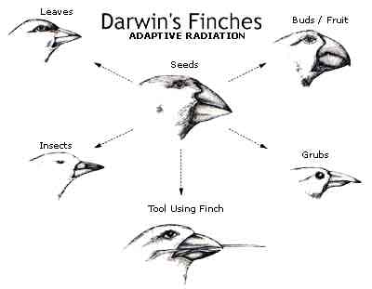

Slide 15
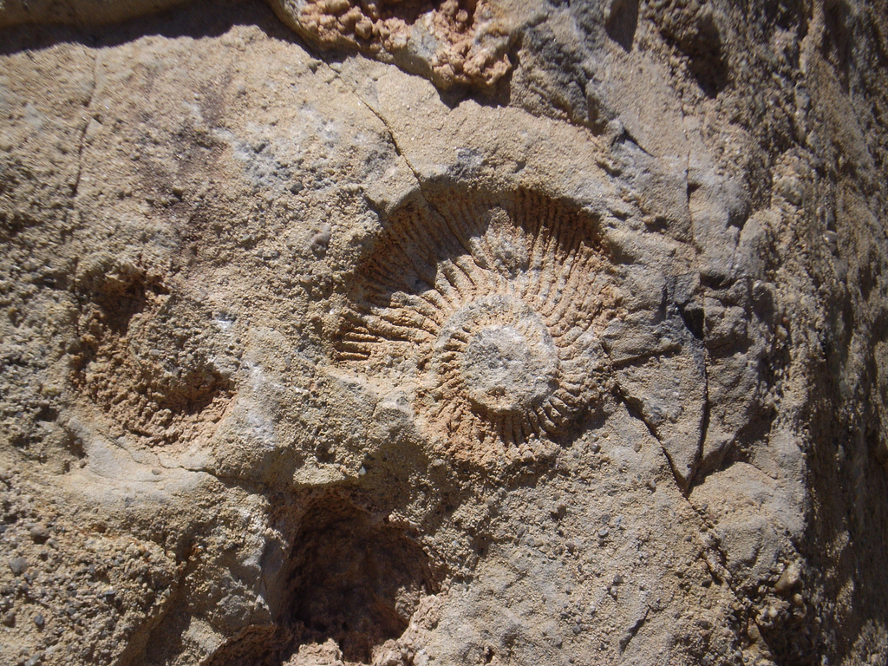
Fossil and Geological Evidence
Darwin noticed that some fossils looked similar to living species, suggesting that the living species might have a relationship with the fossil forms. This led Darwin to reason that the Earth must have been greater than 6000 years old.
Darwin also found fossil shells of marine organisms high up the Andes mountains! When he experienced an Earthquake, he noticed that land that had been underwater shifted above sea level.

Slide 16
10.4 Evidence of Evolution
After this section you will be able to……
Identify different sources that provide evidence to evolution
Compare and contrast homologous and analogous structures
Explain what vestigial structures are and how they provide clues to the history of species

Slide 17
Non-Darwin Sources
During Darwin’s time we did not understand genetic inheritance. Darwin used other sources to help support his ideas.
Fossils
Geography
Embryology
Anatomy

Slide 18
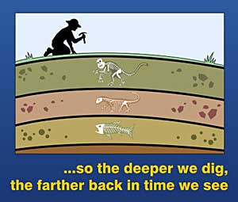
Fossils
Scientists before Darwin knew that organisms changed over time. Those who studied fossils noticed that different layers of rocks contained different organisms. The bottom layers of the rock are the oldest while the upper layers contain the most recent organisms.

Slide 19
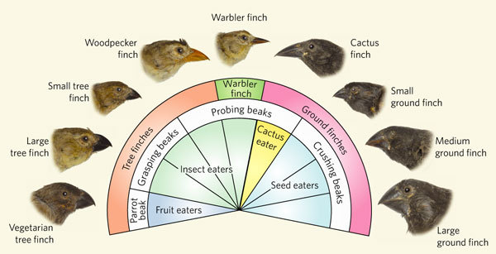
Geography
Darwin noticed that plants and animals present on each island looked similar, but not exactly the same. He hypothesized that organisms from the mainland had migrated to the islands.
Different islands had different food sources, climates, and predators. These various environmental conditions favored different traits in these migrant organisms.
Biogeography is the study of the distribution of organisms around the world.

Slide 20
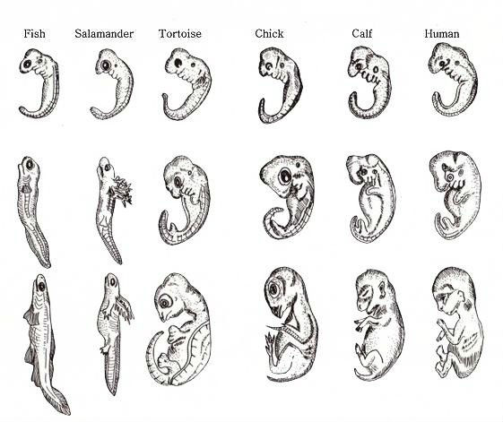
Developmental Similarities
Darwin also noticed that embryos of different species look very similar. In chordate embryos, their pharyngeal arches develop into structures of the face, ears, and jaws. However, the lower arches develop into gills in fish.
The similar features of embryos in very different organisms suggest evolution from a distant common ancestor.

Slide 21
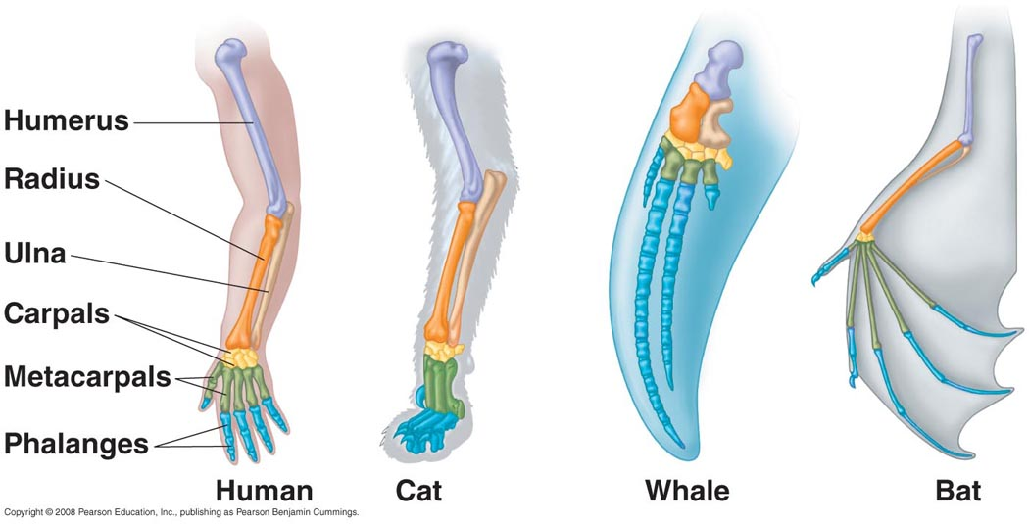
Anatomy
Comparing body parts of different species can provide strong evidence of evolution. Darwin noticed that different organisms have similar body parts, but have different functions.
Homologous structures are features that are similar in structure, but appear in different organisms and may have different functions. E.g. front limbs in humans/cats/whales/bats

Slide 22
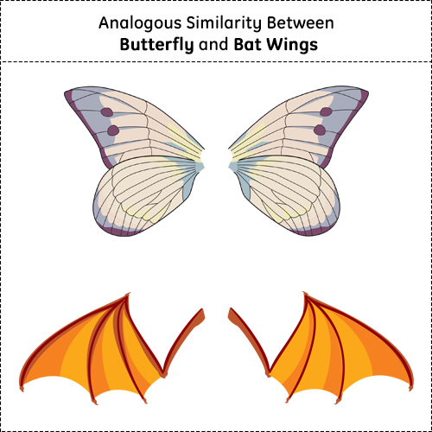
Anatomy
Analogous structures are structures that perform a similar function, but are not similar in origin. E.g. birds/butterflies
Note that, just because two organisms share similar structures does NOT mean they are closely related. Homologous structures show common ancestry, but analogous structures do not.

Slide 23
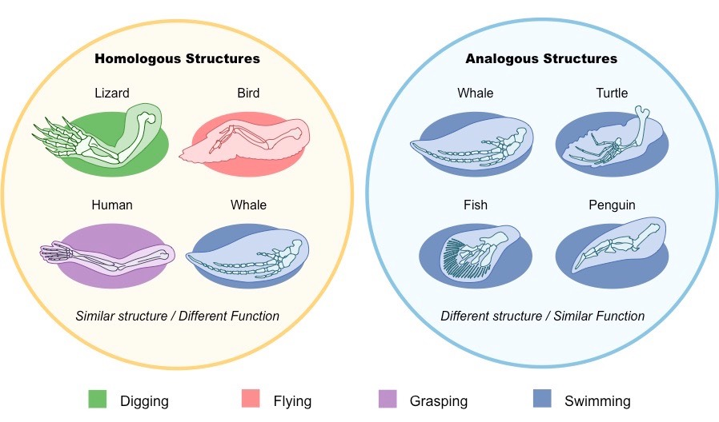

Slide 24
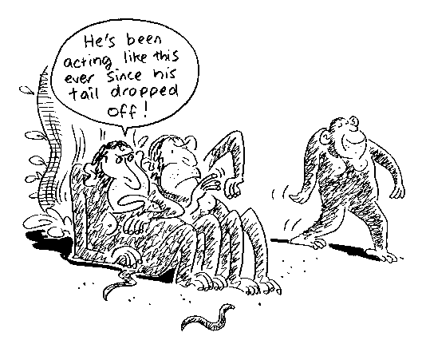
Structural Patterns Providing Clues
Vestigial structures are remnants of organs or structures that had a function in an early ancestor.
E.g. snakes and whales have tiny pelvic bones, even though neither organisms walk!

Slide 25
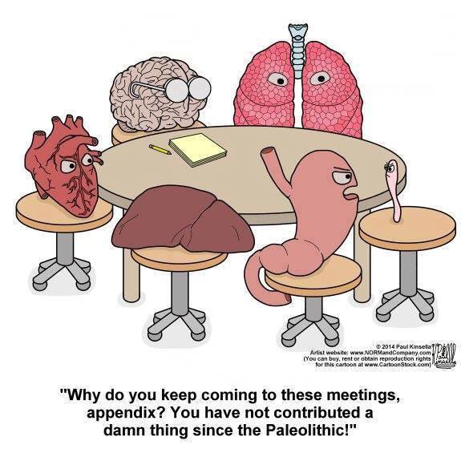
Structural Patterns Providing Clues
In humans, the appendix is considered a vestigial structure. It’s believed that the appendix is a remnant of an organ that helped digest certain plants by human ancestors.

Slide 26
10.3 Theory of Natural Selection
After this section you will be able to……
Compare and contrast artificial and natural selection
Explain how evolution can occur
Describe what adaptations are

Slide 27
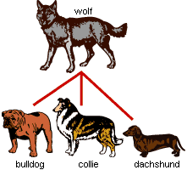
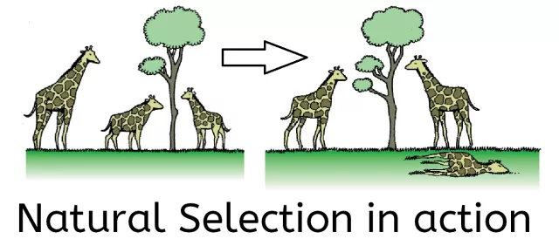
Key Insights
Artificial Selection is when humans select individuals with desired traits in an organism and breed them to produce more individuals with those same traits
Heritability is the ability of a trait to be passed down from one generation to the next.
Natural Selection is a process in which individuals that have inherited beneficial produce more offspring than do other individuals

Slide 28
Struggle for Survival
Thomas Malthus proposed that resources such as food, water, and shelter limited human population growth. This led to Darwin reasoning that a similar struggle happens in nature.
A population is all the individuals of a species that live in an area and noticed individuals in those populations would match the environment they lived in. Darwin proposed that it took many generations to show these adaptations in a process called “descent with modification.”

Slide 29
Natural Selection
Another scientist, Alfred Wallace, independently developed an explanation of how evolution occurs, which was very similar to Darwin’s. In the 1850’s the ideas of both scientists were presented to the scientific community.
Variation is when individuals of a species differ due to genetic variation
Overproduction is when organisms have more offspring than can survive resulting in competition
Adaptation is when some individuals have certain variations that allow them to survive better in their environment
Descent with modification is when beneficial adaptations are produced in more of the next generation with the same environmental conditions
Fitness is a measure of the ability to survive and reproduce.

Slide 30
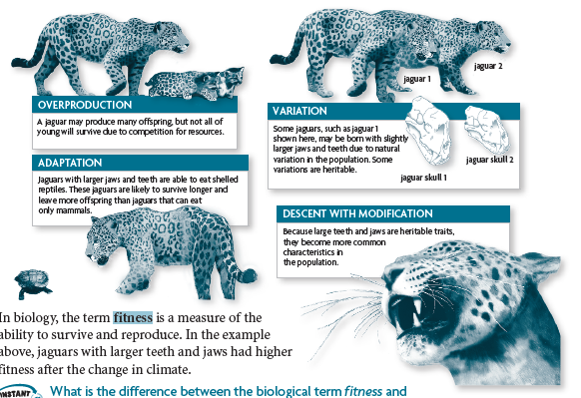

Slide 31
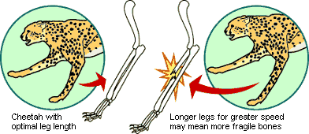
Adaptations as a compromise

Slide 32
11.2 Natural Selection in Populations
After this section you will be able to……
Explain how natural selection affects distribution
Compare and contrast normal distribution, directional selection, stabilizing selection, and disruptive selection

Slide 33
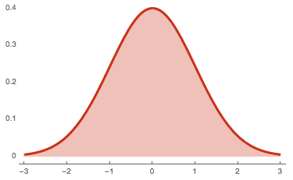
Normal Distribution
A normal distribution is when organized data shows the highest frequency in the middle and the lowest frequency at both ends, or extremes.

Slide 34
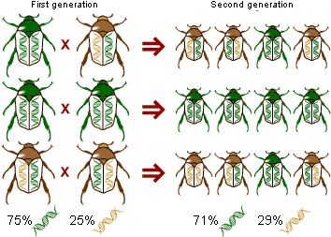
Natural Selection and Distribution
Microevolution is the observable change in the allele frequencies of a population over time. Natural selection is one process that can lead to microevolution.
This can be achieved through directional, stabilizing, and disruptive selection.

Slide 35
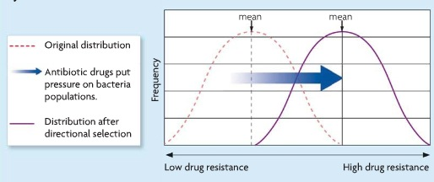
Directional Selection
If selection favors a phenotype at and extreme end of a range we call it directional selection.
A good example of this is antibiotic-resistant bacteria. Bacteria that is resistant to certain antibiotics have an extreme advantage and are able to survive and reproduce.

Slide 36
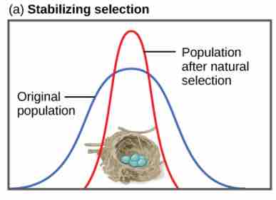
Stabilizing Selection
Selection that favors the middle phenotype is called stabilizing selection. Both extreme phenotypes are selected against.
Robins typically lay four eggs. Larger clutches may result in malnourished chicks while smaller clutches may result in no viable offspring.

Slide 37
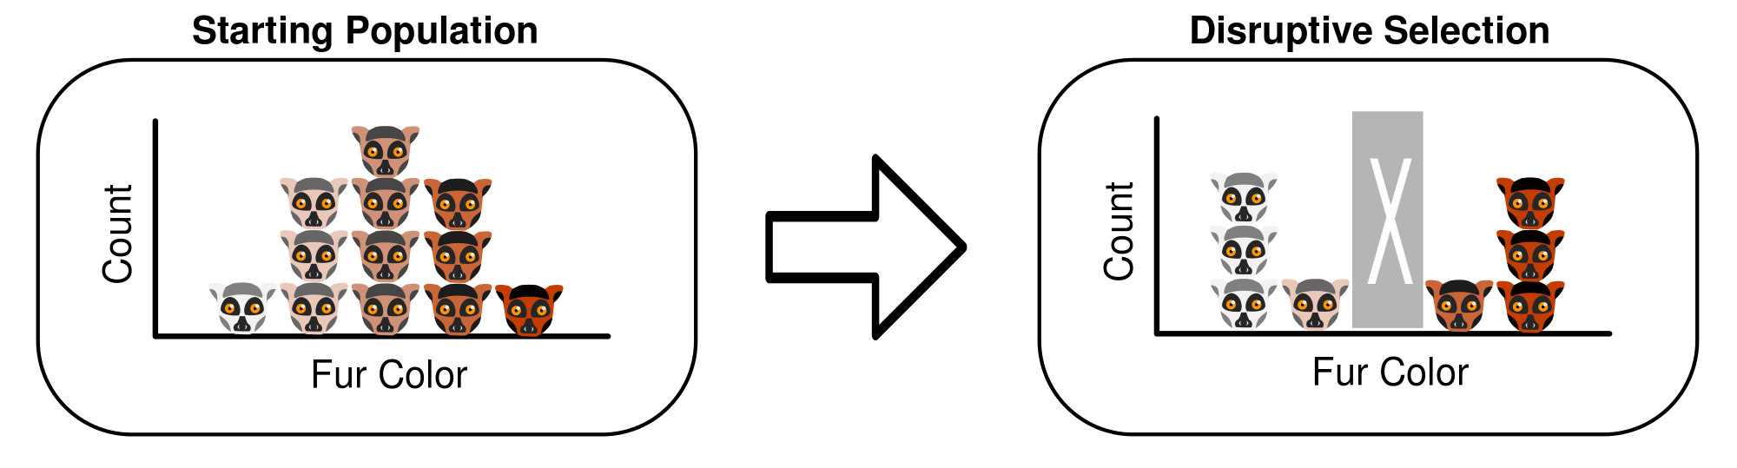
Disruptive Selection
Disruptive selection favors both extreme phenotypes over the mean.

Slide 38
11.1 Genetic Variation Within Populations
After this section you will be able to……
Describe how genetic variation affects survival
Explain where genetic variation comes from

Slide 39
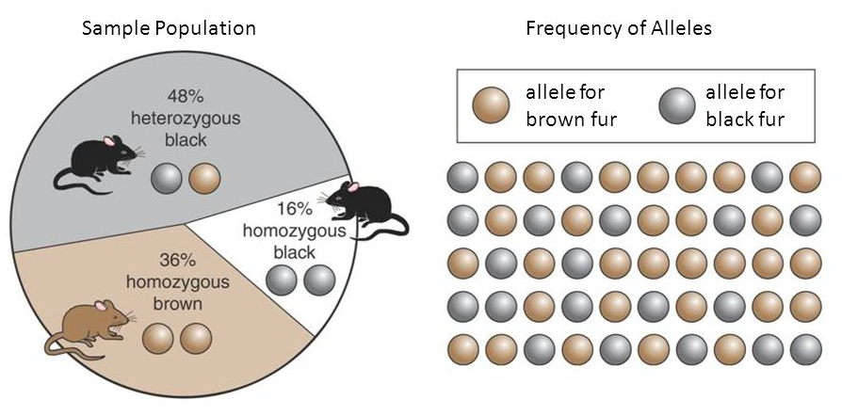
Genetic Variation
A gene pool is made up of all of the alleles of all of the individuals in a population.
An allele frequency is a measure of how common an allele is in a population.

Slide 40

Mutation
Mutation A random change in the genetic code produced by a mistake in the copying process
When mutations occur in cells responsible for reproduction (gametes) those mutations can be passed on to the next generation.
Sometimes a mutation improves an organism’s chance of survival or reproduction. If such a mutation is passed along to the next generation, it adds new genetic diversity to the population.
https://www.syfy.com/syfywire/marvels-return-of-wolverine-miniseries-gives-logan-new-abilities

Slide 41
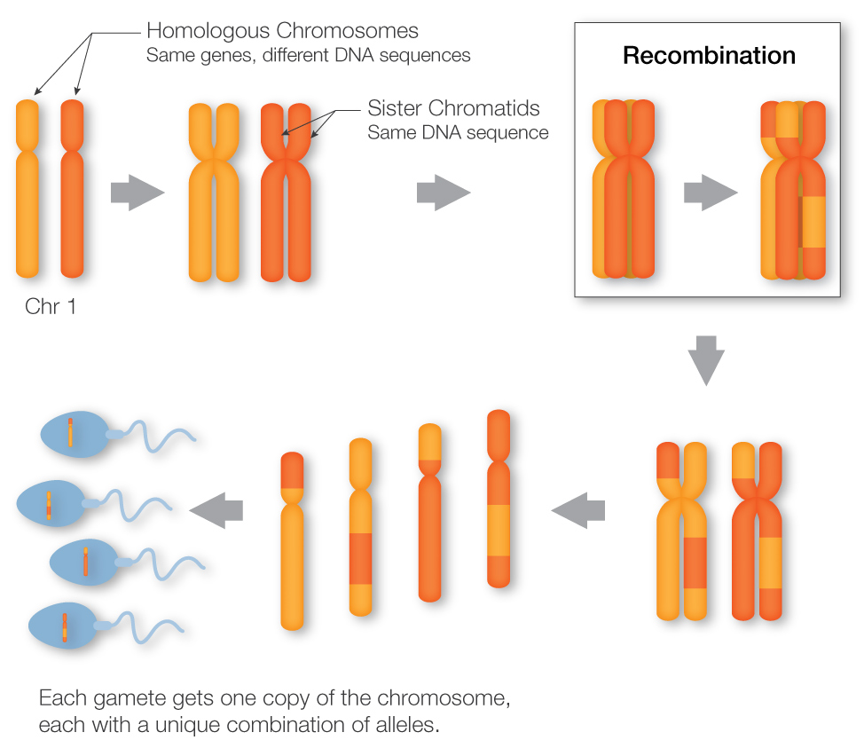
Recombination
Recombination The genetic process by which one chromosome breaks off and attaches to another chromosome during reproductive cell division. (CROSSING-OVER)
This process does not create new genes, but brings together new combinations of alleles on a chromosome, producing new traits.
For example, the human immune system must battle a large variety of viruses and bacteria that regularly attempt to invade the body. Recombination allows new allele combinations to come together, which provides new immune defenses.
https://learn.genetics.utah.edu/content/pigeons/geneticlinkage/

Slide 42
11.3 Other Mechanisms of Evolution
After this section you will be able to……
Describe the effects of gene flow
Describe the effects of genetic drift with both the bottleneck effect and founder effect
Describe sexual selection

Slide 43
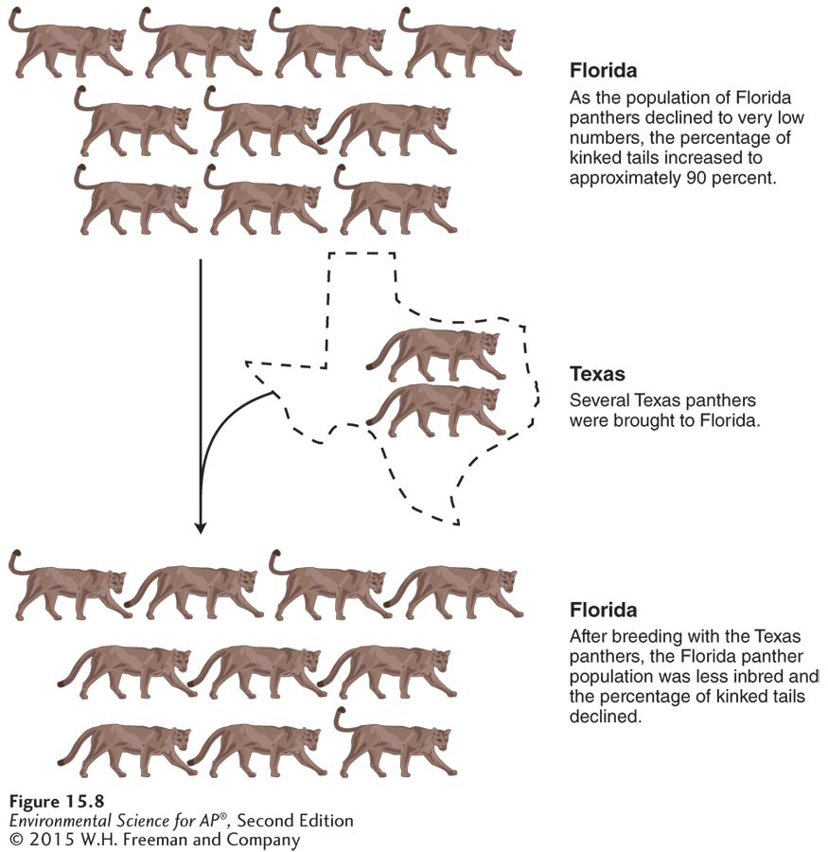
Gene Flow
Evolution by gene flow.
As the Florida panther declined in population size, the animals experienced low genetic variation and showed signs of inbreeding, which lead to kinky tails, heart defects, and low sperm counts. With the introduction of eight
panthers from Texas, the Florida population experienced a decline
in the prevalence of defects and a growth in population from 30 to 160
individuals.

Slide 44
Genetic Drift
Genetic drift A change in the genetic composition of a population over time as a result of random mating.
Like mutation and gene flow, genetic drift is a nonadaptive, random process.
Can be particularly important role in altering the genetic composition of small populations.

Slide 45
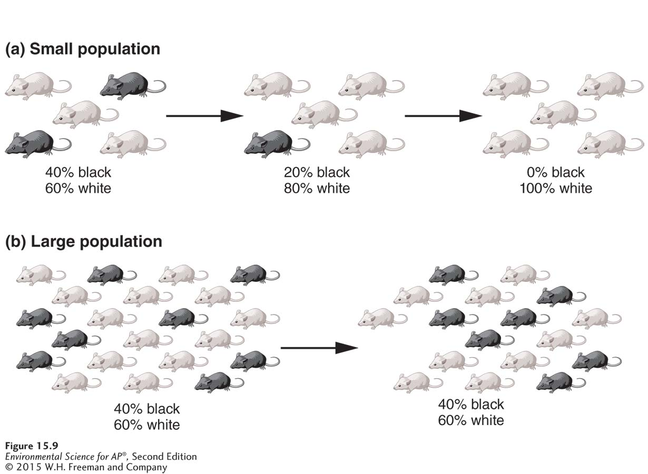
Genetic Drift
Evolution by genetic drift. (a) In a small population, some less-common genotypes can be lost by chance as random mating among a small number of individuals can result in the less-common genotype not mating. As a result, the genetic composition can change over time. (b) In a large population, it is more difficult for the less-common genotypes to be lost by chance because the absolute number of these individuals is large. As a result, the genetic composition tends to remain the same over time in larger populations.

Slide 46
Bottleneck Effect (genetic drift)
Bottleneck effect A reduction in the genetic diversity of a population caused by a reduction in its size.
Reduced population numbers means reduced genetic variation.
Low genetic variation in a population can cause increased risk of disease and low fertility.
The bottleneck effect means species are less able to adapt to future environmental changes.
Resulting low diversity can lead to decline and extinction.
Extinction The death of the last member of a species.

Slide 47
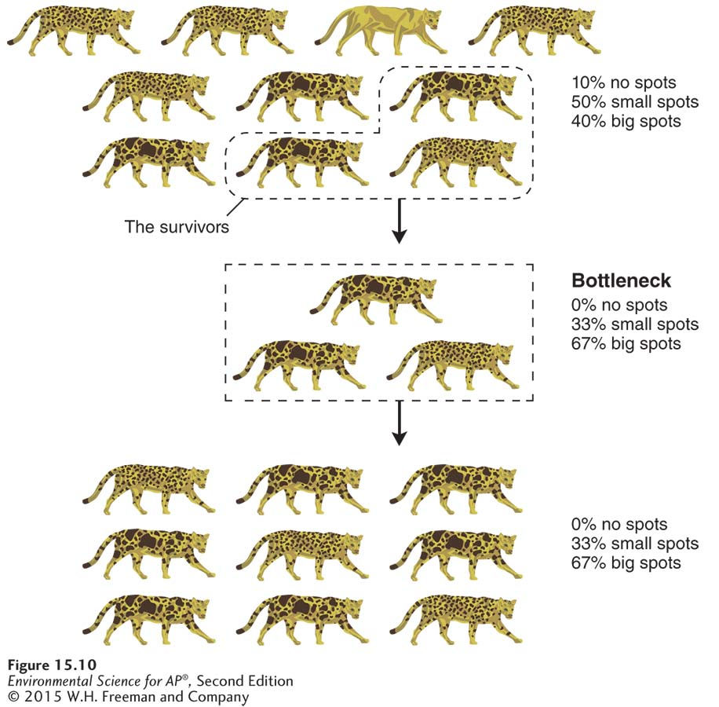
Bottleneck Effect
(genetic drift)
Evolution by the bottleneck effect. If a population experiences a drastic decrease in size (goes through a “bottleneck”), some genotypes will be lost, and the genetic composition of the survivors will differ from the composition of the original group.

Slide 48
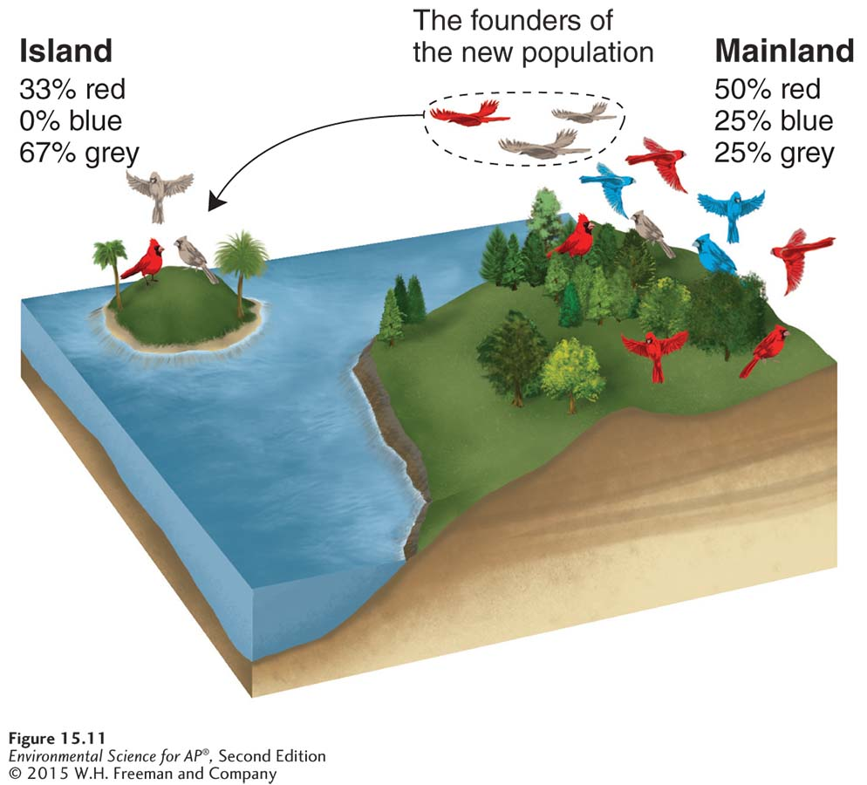
Founder Effect (genetic drift)
Founder effect A change in the genetic composition of a population as a result of descending from a small number of colonizing individuals.
Evolution by the founder effect. If a few individuals from a mainland population colonize an island, the genotypes on the island will represent only a subset of the genotypes present in the
mainland population. As with the bottleneck effect, some genotypes will not be present in the new population.

Slide 49
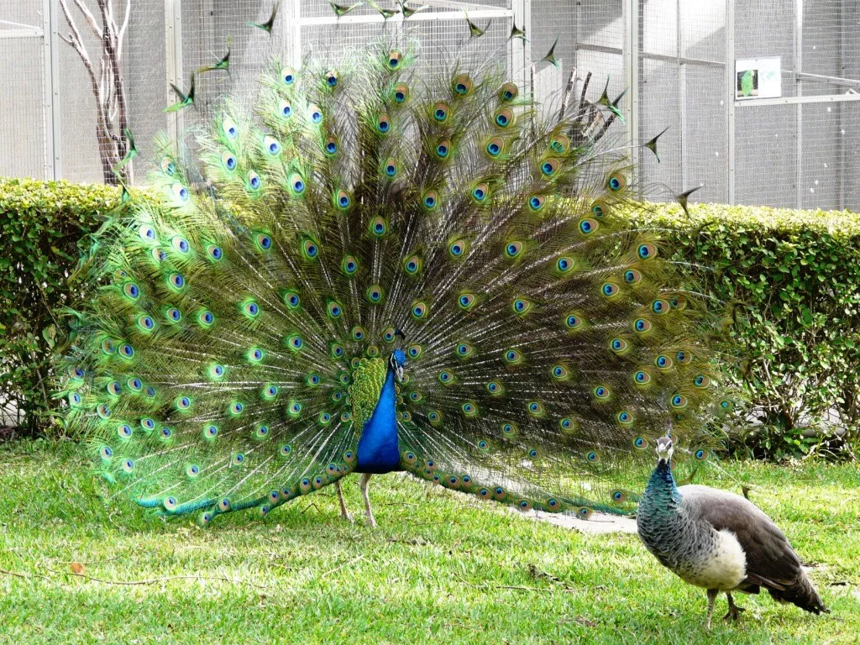
Sexual selection
Sexual selection occurs when a trait ↑ mating success and gets passed onto the next generation. These traits are usually showy, such as bright coloring or large antlers. Some of these traits are linked with genes for good health and fertility.

Slide 50
11.5 Speciation Through Isolation
After this section you will be able to……
Describe reproductive isolation and speciation
Compare and contrast behavioral isolation, geographical isolation, temporal isolation

Slide 51
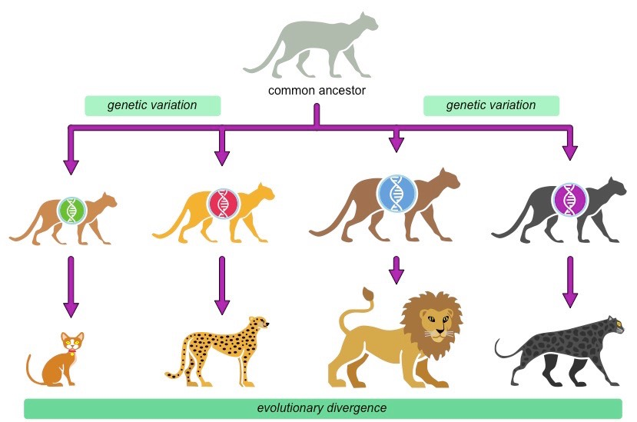
Isolation
When gene flow between two populations stops, the populations are said to be isolated. Over time, isolated populations become more and more genetically different.
Reproductive Isolation is when members of different populations can no longer mate successfully. This is the last step in speciation, the process of one species becoming two or more separate species.

Slide 52
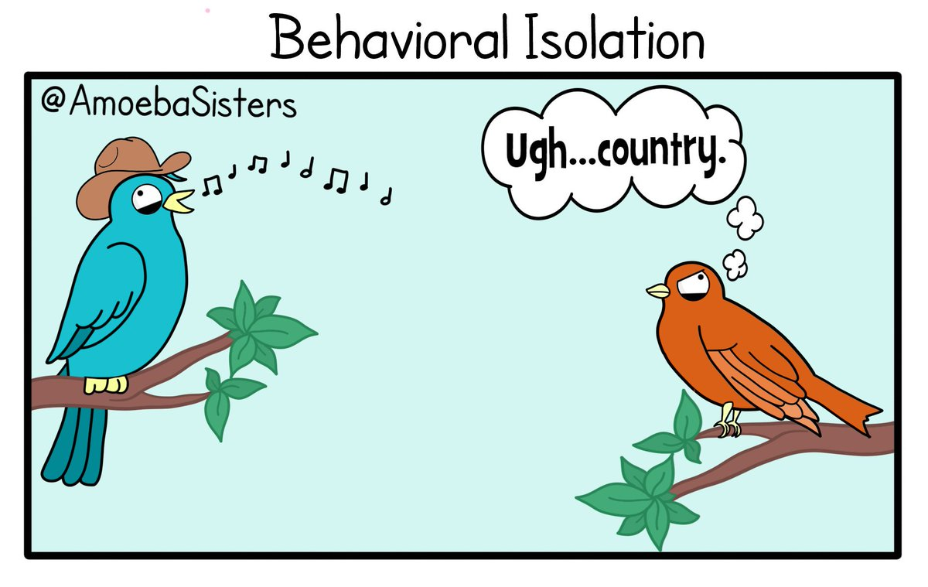
Behavioral Isolation
Behavioral isolation is caused by differences in courtship and mating behaviors. Fireflies, for example, produce different patterns of flashes that attract mates of their own species.

Slide 53
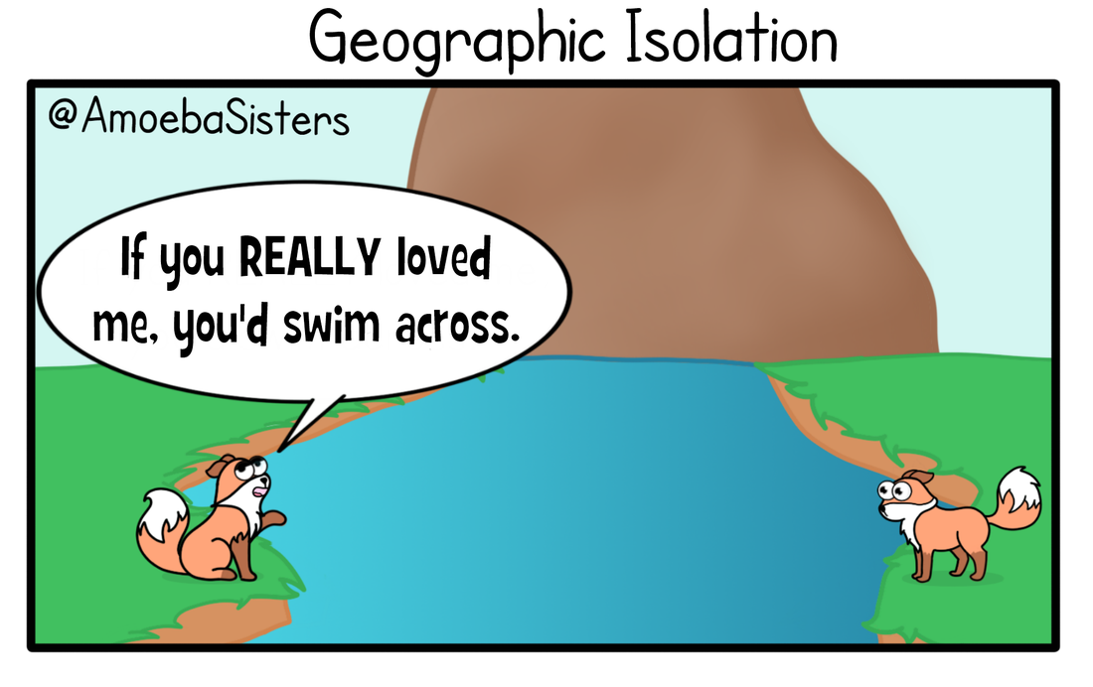
Geographic Isolation
Geographic isolation is caused by physical barriers, such as rivers or mountains, that divides a population into two or more groups.

Slide 54
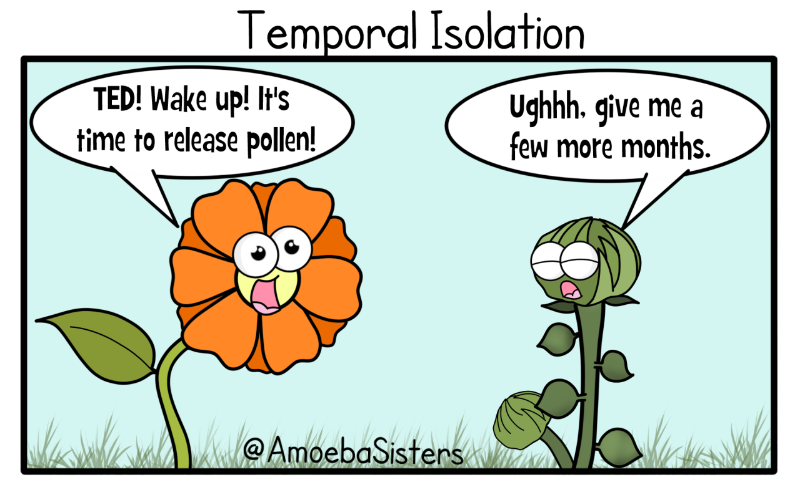
Temporal Isolation
Temporal isolation occurs when timing prevents reproduction between populations. Reproduction periods may change to a different time of year or day.

Slide 55
11.4 Hardy-Weinberg Equilibrium
After this section you will be able to……
Describe the Hardy-Weinberg equilibrium model
Explain the five factors that lead to evolution

Slide 56
Hardy-Weinberg Equilibrium
Developed in 1908, Hardy-Weinberg equilibrium is a model used to study the changing of a population. In this model, equilibrium refers to genotype frequencies that stay the same from generation to generation. This means that if a genotype stays in equilibrium then it is not evolving.
Populations that meet these five conditions are said to be in Hardy-Weinberg equilibrium.
Very large population - no genetic drift can occur
No emigration or immigration - no gene flow can occur
No mutations - no new alleles
Random mating - no sexual selection can occur
No natural selection - all traits must equally help in survival

Slide 57
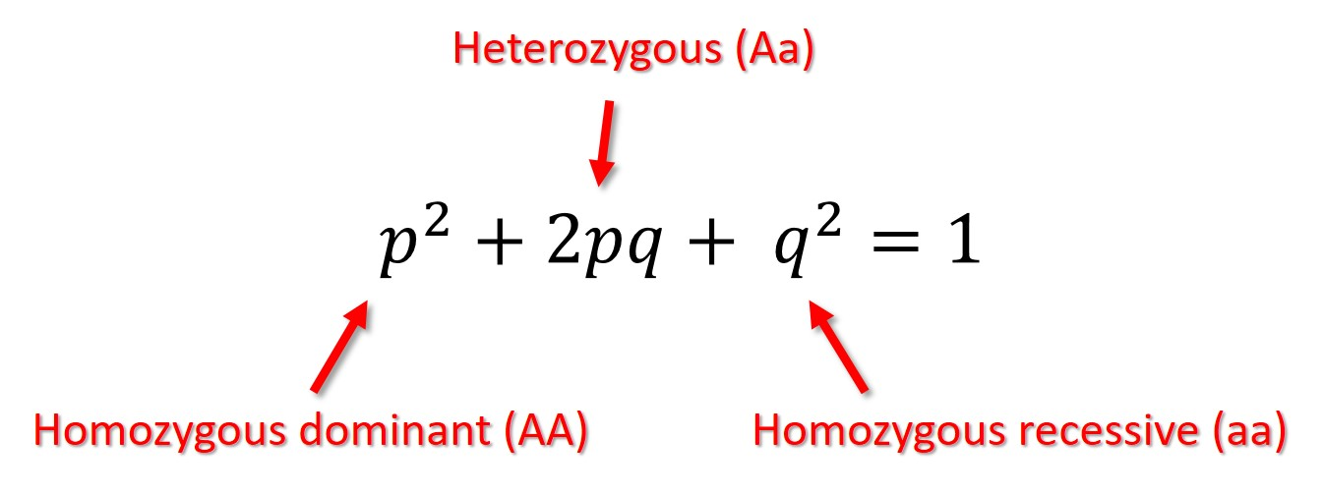
Predicting Genotype Frequencies
The Hardy-Weinberg equation can be used to predict genotype frequencies for simple dominant-recessive traits in a population. The equation predicts the values that would be present if the population is in equilibrium.
p = frequency of the dominant allele
q = frequency of the recessive allele
p² + 2pq + q² = 1

Slide 58
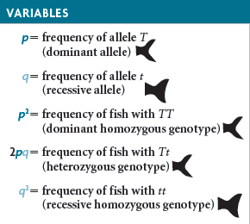
Example Problem
In a population of 1000 fish, 640 have forked tail fins and 360 have smooth tail fins. Tail fin shape is determined by two alleles: T is dominant for forked and t is recessive for smooth.
Determine frequency of the homozygous recessive genotype (q²)
Determine the predicted value of a recessive allele (q)
Use p + q = 1 to find the predicted value of dominant allele (p)
Calculate the predicted genotype frequencies from the predicted allele frequencies

Slide 59
Example Problem
In a population of 1000 fish, 640 have forked tail fins and 360 have smooth tail fins. Tail fin shape is determined by two alleles: T is dominant for forked and t is recessive for smooth.
Determine frequency of the homozygous recessive genotype (q²)
q² = 360/1000 = 0.36

Slide 60
Example Problem
In a population of 1000 fish, 640 have forked tail fins and 360 have smooth tail fins. Tail fin shape is determined by two alleles: T is dominant for forked and t is recessive for smooth.
q² = 360/1000 = 0.36
Determine the predicted value of a recessive allele (q)
Find the square root of q²
q = sqrt(0.36) = 0.6

Slide 61
Example Problem
In a population of 1000 fish, 640 have forked tail fins and 360 have smooth tail fins. Tail fin shape is determined by two alleles: T is dominant for forked and t is recessive for smooth.
q² = 360/1000 = 0.36
q= sqrt(0.36) = 0.6
Use p + q = 1 to find the predicted value of dominant allele (p)
p + q = 1
p + 0.6 = 1
p = 0.4

Slide 62
Example Problem
In a population of 1000 fish, 640 have forked tail fins and 360 have smooth tail fins. Tail fin shape is determined by two alleles: T is dominant for forked and t is recessive for smooth.
q² = 360/1000 = 0.36
q= sqrt(0.36) = 0.6
p = 0.4
Calculate the predicted genotype frequencies from the predicted allele frequencies
p² = 0.4² = 0.16
2pq = 2 x (0.4) x (0.6) = 0.48
Q² = 0.6² = 0.36

Slide 63
Example Problem
In a population of 1000 fish, 640 have forked tail fins and 360 have smooth tail fins. Tail fin shape is determined by two alleles: T is dominant for forked and t is recessive for smooth.
q² = 360/1000 = 0.36
q= sqrt(0.36) = 0.6
p = 0.4
p² = 0.4² = 0.16
2pq = 2 x (0.4) x (0.6) = 0.48
Q² = 0.6² = 0.36
Therefore,
16% have forked tails (TT)
48% have forked tails (Tt)
36 % have smooth tails (tt)

Slide 64
Five Factors Leading to Evolution
Remember, evolution is continuous. Environments are always changing, although very slowly. Evolution is a response to these changes. When the changes happen, populations either adapt or go extinct.
Genetic Drift
Gene Flow
Mutation
Sexual Selection
Natural Selection

Slide 65
11.6 Patterns in Evolution
After this section you will be able to……
Compare and contrast convergent and divergent evolution
Explain the process of coevolution
Explain extinction in the forms of background extinction and mass extinctions
Describe patterns in speciation

Slide 66
Natural Selection Is Not Random
In science, random means that it something happens by chance and cannot be predicted. Mutation and genetic drift are random events because they cannot be predicted. These random events are sources of genetic diversity.
Natural selection is also not random. Individuals with beneficial traits are more likely to survive and reproduce than individuals without those traits.
Two ways that natural selection can direct a population’s traits are through convergent evolution and divergent evolution.

Slide 67
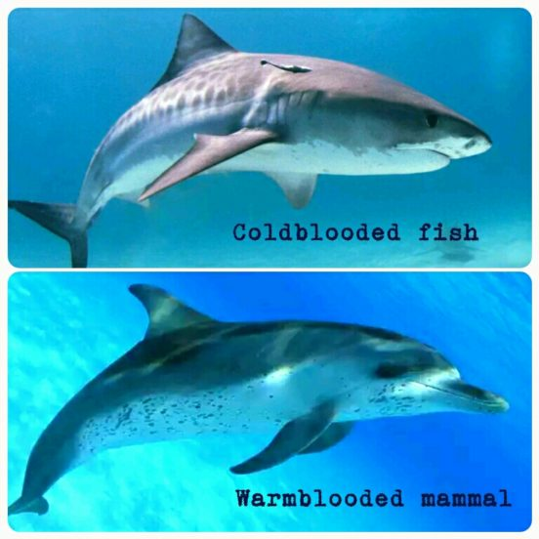
Convergent Evolution
Convergent evolution is when unrelated species evolve similar characteristics. Examples include wings on birds and insects.

Slide 68
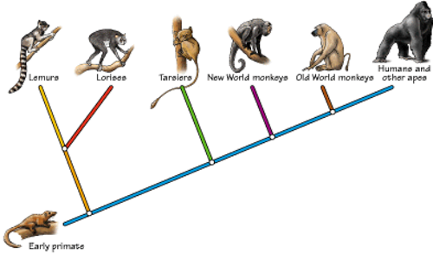
Divergent Evolution
Divergent evolution is when closely related species evolve in different directions and become increasingly different.

Slide 69
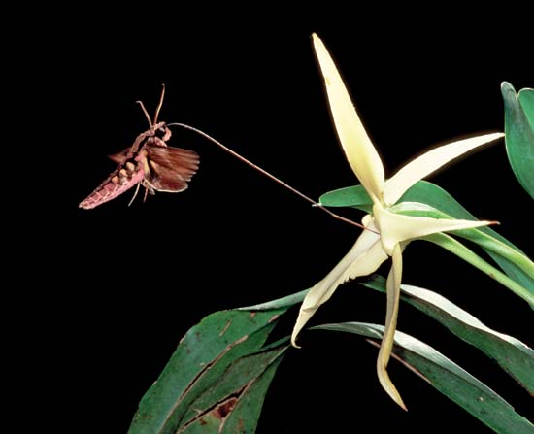
Coevolution
Coevolution is the process in which two or more species evolve in response to change in each other. In some cases it’s beneficial while other cases it’s competition.

Slide 70
Extinction
Extinction is the permanent loss of a species from Earth. This is a natural process that can be divided into two categories.
Background extinction occurs continuously, but at a low rate. Usually only one or a few species are affected.
Mass extinctions destroy many species, often all across Earth. They are thought to occur suddenly in geologic time due to dramatic events such as ice age or an asteroid impact. There have been at least five mass extinctions in the last 600 million years.

Slide 71
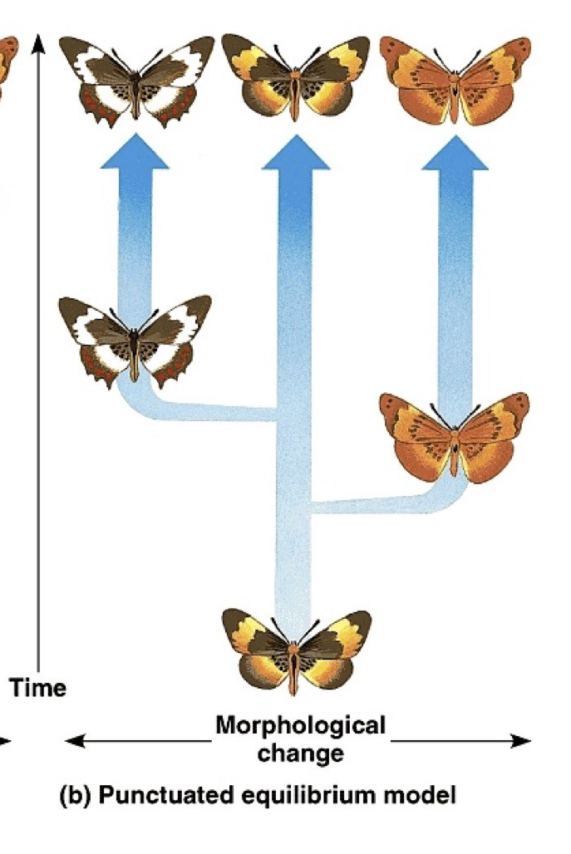
Punctuated Equilibrium
Punctuated equilibrium describes the pattern of long periods of little change interrupted by shorter periods of intense evolutionary events, such as speciation.

Slide 72


Adaptive Radiation
Adaptive radiation is when evolution splits one species into a number of different species, each one being adapted to a different environment.

